Slide 1
Progress Report (3rd Week)
Presented by Credo
28/08/2020

Slide 2
SateLoc: A Virtual Fingerprinting Approach to Outdoor LoRa Localization using Satellite Images
Yuxiang Lin^{1,2}, Wei Dong^{1,2}, Yi Gao^{1,2}, and Tao Gu³
¹ College of Computer Science, Zhejiang University
² Alibaba-Zhejiang University Joint Institute of Frontier Technologies, China
³ Computer Science and Information Technology, RMIT University

Slide 3
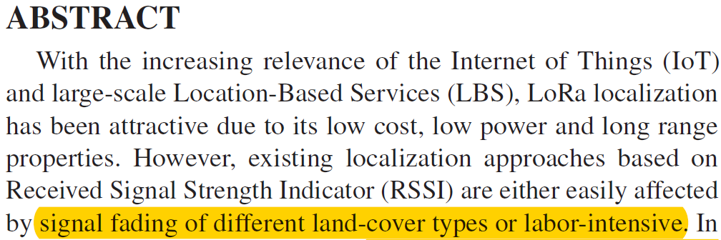
Motivation
Log-distance path loss model

Slide 4
Related Work
LoRa-based localization systems
Measurement Type | Reference | Target Type | Location Error | Specific Device | Location Estimation | Using Env-context | Site Survey
TDOA | Fargas et al. ^{[1]} | Stationary | > 100m | N | Multilateration | N | N
 | StarLight ^{[2]} | Mobile | > 100m | N | Multilateration | N | N
 | μLocate ^{[3]} | Mobile | < 2m | Y | Trilateration | N | N
RSSI | Lam et al. ^{[4]} | Mobile | [20m, 40m] | N | Standard log-normal model | N | N
 | Demetri et al. ^{[5]} | Mobile |  | N | Okumura-Hata model | Y | X
 | Sallouha et al. ^{[6]} | Mobile | 50m | N | Fingerprinting | Y | Y
[1] Bernat Carbonés Fargas and Martin Nordal Petersen. GPS-free geolocation using LoRa in low-power WANs. In IEEE GIoTS, IEEE, 2017.
[2] Nico Podevijn, David Plets, Jens Trogh, Luc Martens, Pieter Suanet, Kim Hendrikse, and Wout Joseph. TDoA-based outdoor positioning with tracking algorithm in a public LoRa network. Wireless Communications and Mobile Computing (WCMC), 2018.
[3] Rajalakshmi Nandakumar, Vikram Iyer, and Shyamnath Gollakota . 3D Localization for Sub-Centimeter Sized Devices. In Proceedings of the 16th ACM Conference on Embedded Networked Sensor Systems (SenSys), ACM, 2018.
[4] Ka-Ho Lam, Chi-Chung Cheung, and Wah-Ching Lee. New rssi-based lora localization algorithms for very noisy outdoor environment. In Proceedings of 42nd Annual Computer Software and Applications Conference (COMPSAC), IEEE, 2018.
[5] Silvia Demetri, Marco Zúñiga, Gian Pietro Picco, Fernando Kuipers, Lorenzo Bruzzone, and Thomas Telkamp. Automated Estimation of Link Quality for LoRa: A Remote Sensing Approach. In Proceedings of 18th ACM/IEEE International Conference on Information Processing in Sensor Networks (IPSN), 2019.
[6] Hazem Sallouha, Alessandro Chiumento, and Sofie Pollin. Localization in long-range ultra narrow band IoT networks using RSSI. In Proceedings of the International Conference on Communications (ICC), IEEE, 2017.

Slide 5
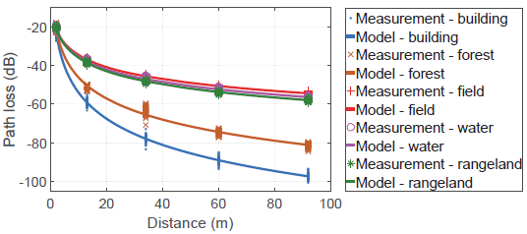
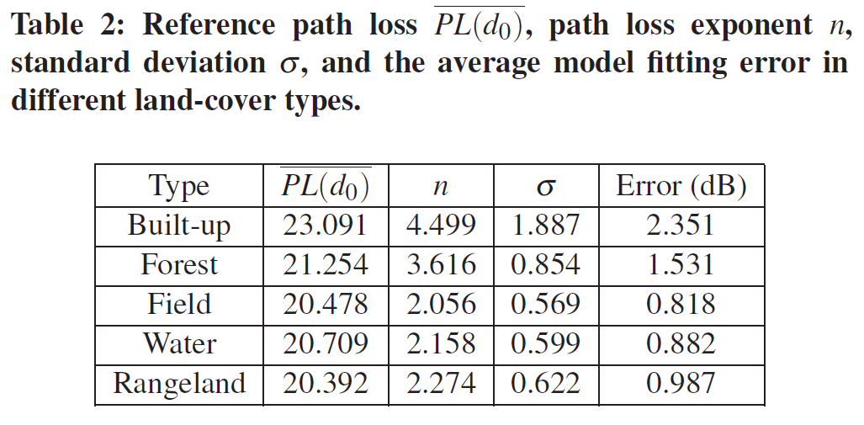
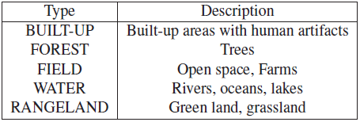
Interference of Land-cover Type
Field experiment
Different land-cover types’ path loss parameters are different!

Slide 6
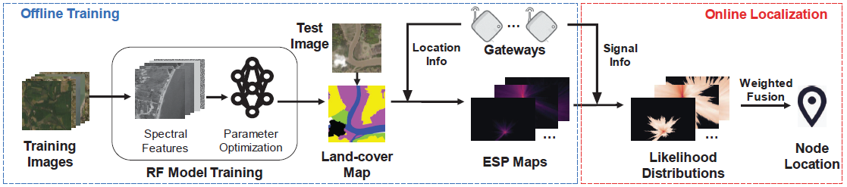
System Design
Identifying the cover-type can help build a more practical model.
Obtaining the information from the high-resolution satellite images is low-cost.
Field Experiment
Ilke Demir, Krzysztof Koperski, David Lindenbaum, Guan Pang, Jing Huang, Saikat Basu, Forest Hughes, Devis Tuia, and Ramesh Raskar. DeepGlobe 2018: A Challenge to Parse the Earth Through Satellite Images. In Proceedings of the 2018 IEEE/CVF Conference on Computer Vision and Pattern Recognition Workshops (CVPRW), IEEE, 2018.

Slide 7
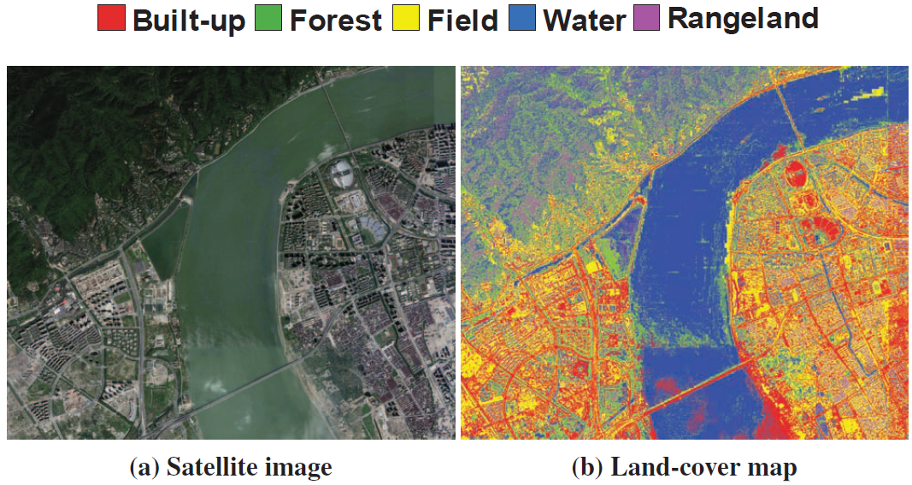
Land-cover Type Classification
Classification result

Slide 8
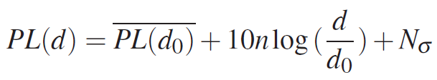
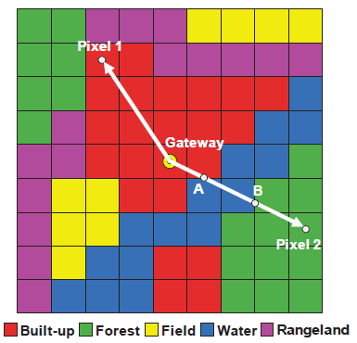

ESP Maps Generation
Log-distance path loss model
Path loss exponent of the corresponding environment
PL() is ESP:

Slide 9
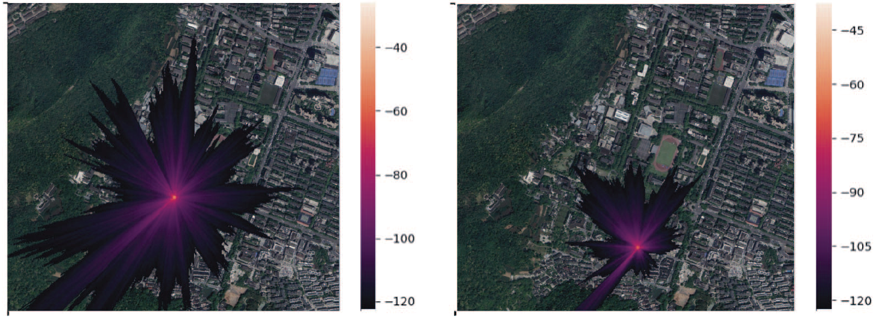
ESP Maps Generation
Result
Sparse buildings
Dense buildings
ESP map is strongly influenced by the environmental context.

Slide 10
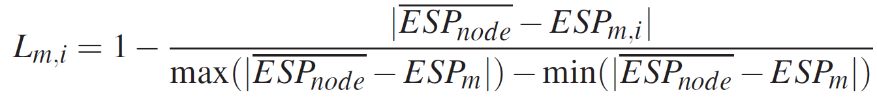
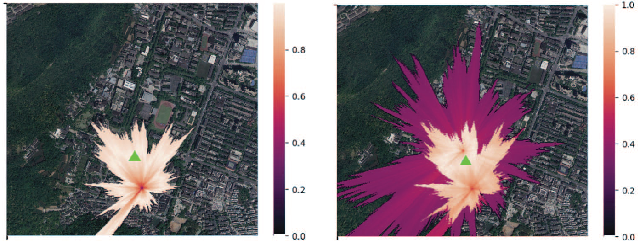
From ESP Map To Location
To likelihood distribution
The likelihood at the i-th pixel of the m-th map:
Measurement
One gateway
Two gateways

Slide 11
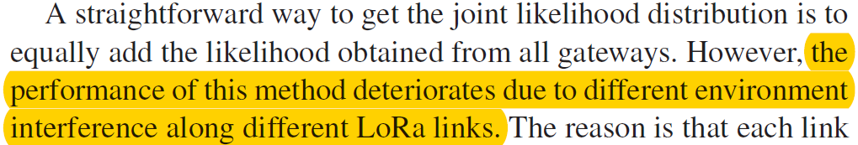
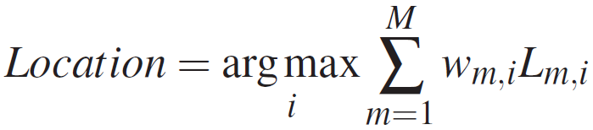
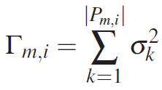
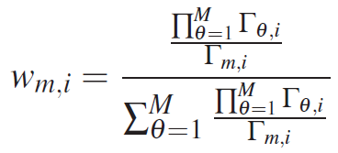
From ESP Map To Location
To likelihood distribution
Environment interference factor
Corresponding weight
A relatively larger environment interference will lead to
a lower weight.
A larger Γ indicates that we should assess less weight on the corresponding link.

Slide 12
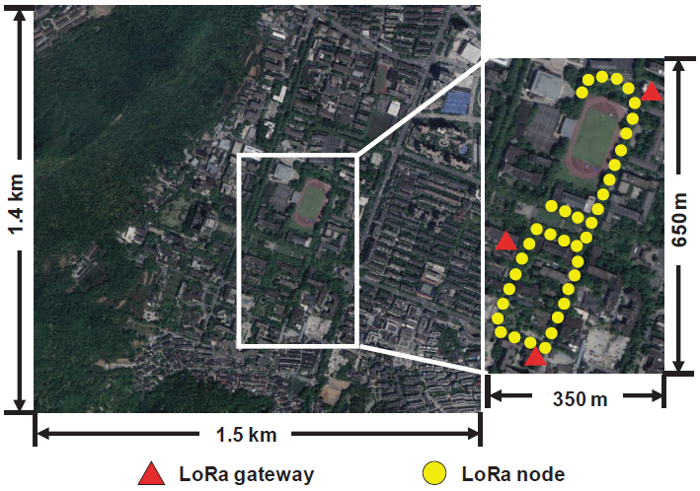
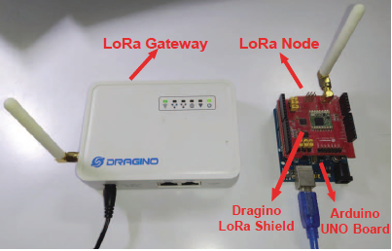
Evaluation
Experiment setup
Off-the-shelf devices
Experiment environment

Slide 13
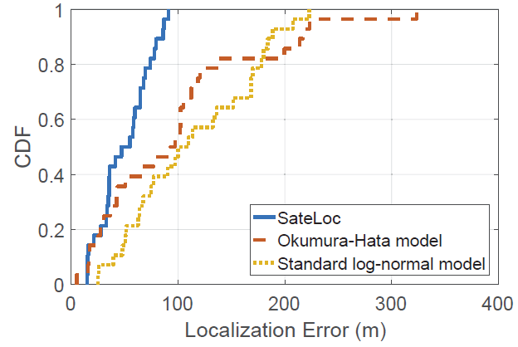
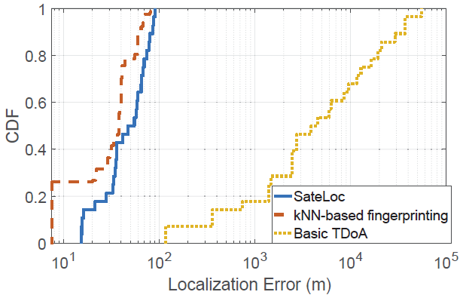
Evaluation
Comparison study
Comparison with model-based approaches
Comparison with fingerprinting-based and TDOA-based approaches

Slide 14
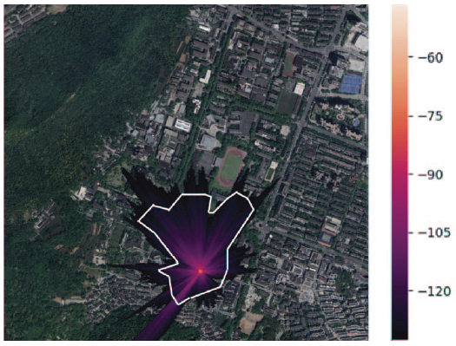
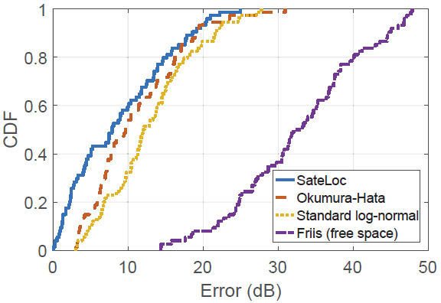
Evaluation
Effectiveness of the ESP map and path loss model
Effectiveness of the ESP map of Yuquan Campus, Zhejiang University. The white lines show the measured signal coverage boundary.
Path loss estimation errors of our iterative aggregation path loss model and existing models.

Slide 15
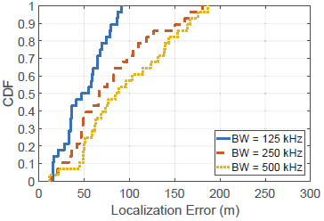
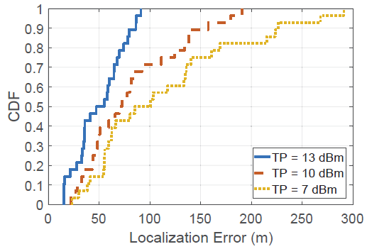
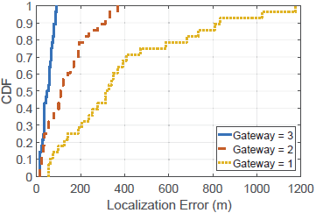
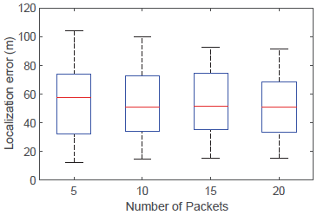
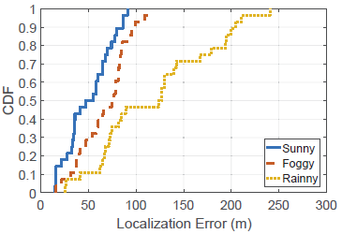
Evaluation
Impact factors
Bandwidth
Transmission Power
Number of gateways
Number of packets
Weather condition

Slide 16
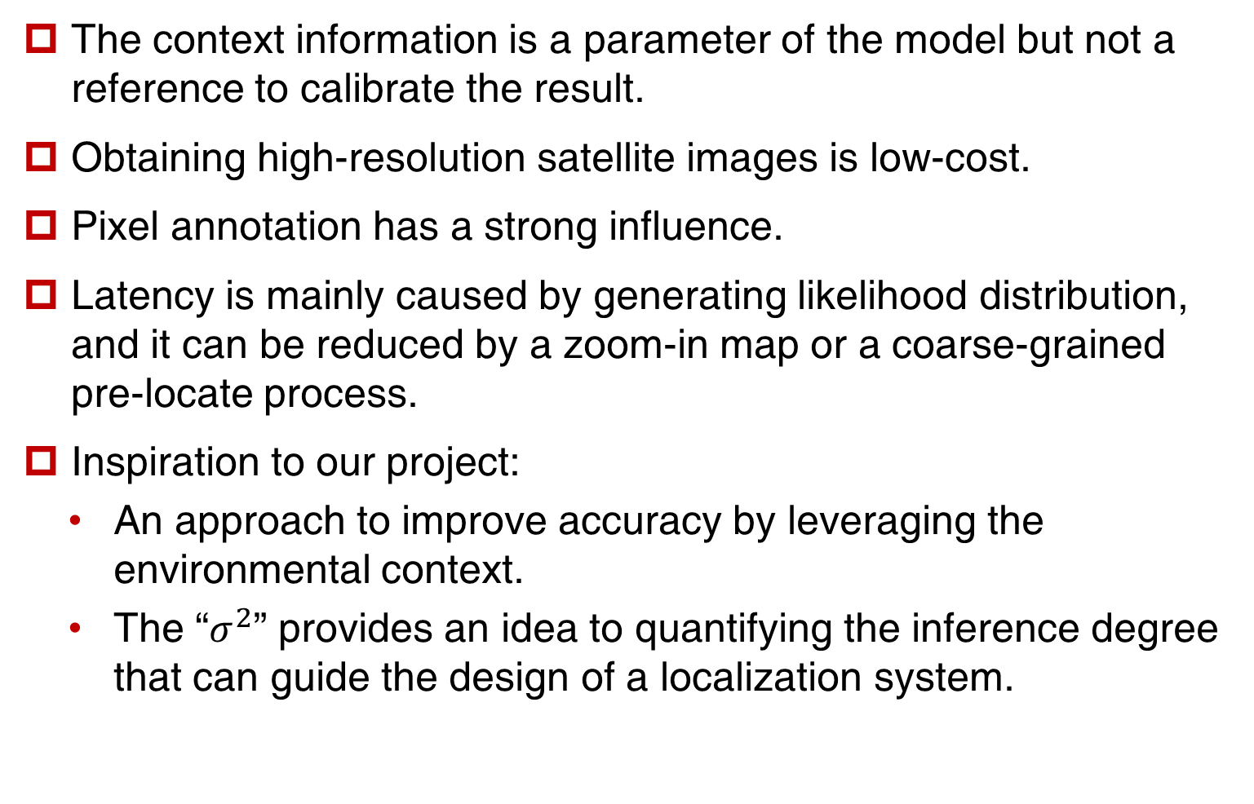
Conclusion & Inspiration
The context information is a parameter of the model but not a reference to calibrate the result.
Obtaining high-resolution satellite images is low-cost.
Pixel annotation has a strong influence.
Latency is mainly caused by generating likelihood distribution, and it can be reduced by a zoom-in map or a coarse-grained pre-locate process.
Inspiration to our project:
An approach to improve accuracy by leveraging the environmental context.
The “$σ^{2}$” provides an idea to quantifying the inference degree that can guide the design of a localization system.

Slide 17
Thanks!

